Slide 1
Data Structures and Algorithms
week 07

Slide 2
Trees
Contents
Concepts
Operations in Binary Tree
Tree Traversal: pre-order, in-order and post-order
Tree Search, insertion/deletion
Height, level and depth of a tree
AVL balanced trees and balancing algorithm
B-tree

Slide 3
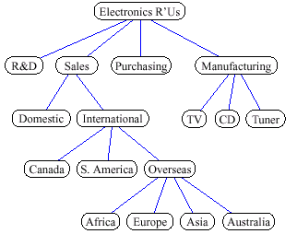
Trees: Some Examples
A tree represents a hierarchy, for example:
Organizational structure of a company

Slide 4
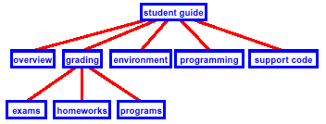
Trees: Some Examples
Table of contents of a book

Slide 5
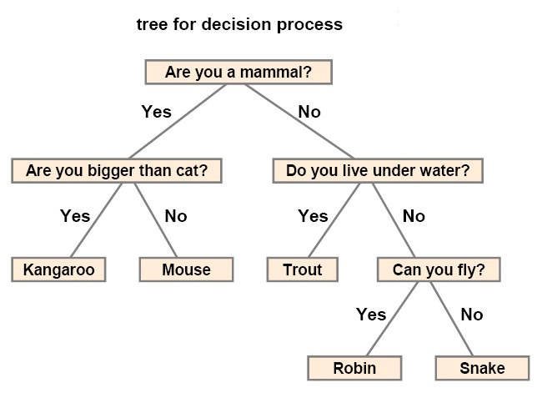
Trees: Some Examples

Slide 6
Tree:Basic Concepts
A tree consists of:
nodes: finite set of elements
branches: directed lines connecting the nodes
For a node:
degree: number of branches associated with the node
indegree: number of branches towards the node
outdegree: number of branches away from the node
For a tree:
root: node with indegree 0
nodes different from the root must have indegree 1

Slide 7
Trees:Terminology
Leaf: node with outdegree 0
Internal node: not a root or a leaf
Parent: node with outdegree greater than 0
Child: node with indegree greater than 0
Siblings: nodes with the same parent
Path: sequence of adjacent nodes
Ancestor: node in the path from the root to the node
Descendent: node in a path from the node to a leaf
Level: the node's distance from the root (at level 0)
Height (Depth): the level of the leaf in the longest path from the root plus 1
Sub-tree: connected structure below the root

Slide 8
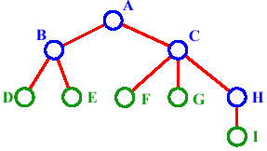
Trees: Terminology
A is the root node
B is the parent of D and E
C is the sibling of B
D and E are the children of B
D, E, F, G, I are external nodes, or leaves
A, B, C, H are internal nodes
The depth, level, or path length of E is 2
The height of the tree is 3

Slide 9
Trees: Representation
General tree
Computer
Case
CPU
3.5" Disk
CD-ROM
Controller
ALU
ROM

Slide 10
Trees: Representation {Contd..}
Indented list
Computer
Case
CPU
Controller
ALU
ROM
...
3.5" Disk
CD-ROM

Slide 11
Trees: Representation {Contd..}
Parenthetical listing
Computer (Case CPU (Controller ALU ROM ...) 3.5" Disk CD-ROM)

Slide 12
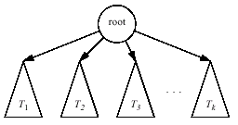
Trees: Viewed Recursively
A sub-tree is also a tree!!

Slide 13
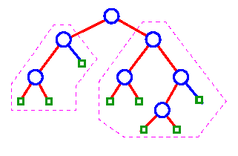
Binary Trees
Binary tree: tree with all internal nodes of degree 2
Recursive View: a binary tree is either
empty
an internal node (the root) and two binary trees (left subtree and right subtree)

Slide 14
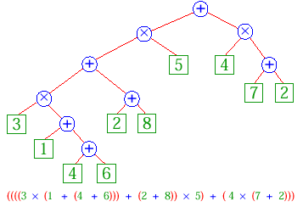
Binary Trees: An Example
Arithmetic expression

Slide 15
Binary Trees: Properties {Contd..}
Completeness:
Complete tree:
N_{max} = 2^{H} − 1
(last level is full)
Nearly complete tree:
H_{min} = ⎣log₂N⎦ + 1
nodes in the last level are
on the left
A
B
C
D
E
F
G
A
B
C
D
E

Slide 16
Binary Trees: Structure
Node
leftSubTree <nodePointer>
data <dataType>
rightSubTree <nodePointer>
End Node

Slide 17
Binary Tree Traversal
Each node is processed once and only once in a predetermined sequence.
Depth-First Traversal
Breadth-First Traversal

Slide 18
Depth-First Traversal
1
2
3
2
3
1
3
1
2
PreOrder
InOrder
PostOrder

Slide 19
Depth-First Traversal:PreOrder
A
B
E
C
D
F
A B C D E F
Processing order

Slide 20
Depth-First Traversal:PreOrder {Contd..}
A
A
B
E
B
E
C
D
F
C
D
F
A B C D E F
Walking order
Processing order

Slide 21
Depth-First Traversal: PreOrder {Contd..}
Algorithm preOrder (val root <nodePointer>)
Traverses a binary tree in node-left-right sequence
Pre root is the entry node of a tree/subtree
Post each node has been processed in PreOrder
1 if (root is not null)
1 process (root)
2 preOrder (root −> leftSubTree)
3 preOrder (root −> rightSubTree)
4 return
End preOrder

Slide 22
Depth-First Traversal: InOrder
A
B
E
C
D
F
C B D A E F
Processing order

Slide 23
Depth-First Traversal: InOrder {Contd..}
A
A
B
E
B
E
C
D
F
C
D
F
C B D A E F
Walking order
Processing order

Slide 24
Depth-First Traversal: InOrder {Contd..}
Algorithm inOrder (val root <nodePointer>)
Traverses a binary tree in left-node-right sequence
Pre root is the entry node of a tree/subtree
Post each node has been processed in InOrder
1 if (root is not null)
1 inOrder (root −> leftSubTree)
2 process (root)
3 inOrder (root −> rightSubTree)
4 return
End inOrder

Slide 25
Depth-First Traversal: InOrder {Contd..}
+
*
d
a * b + c + d
a
+
b
c

Slide 26
Depth-First Traversal: InOrder {Contd..}
(
+
)
(
*
)
d
((a * (b + c)) + d)
a
(
+
)
b
c

Slide 27
Depth-First Traversal: PostOrder
A
B
E
C
D
F
C D B F E A
Processing order

Slide 28
Depth-First Traversal: PostOrder {Contd..}
A
A
B
E
C
D
F
B
E
C
D
F
C D B F E A
Walking order
Processing order

Slide 29
Depth-First Traversal: PostOrder {Contd..}
Algorithm postOrder (val root <nodePointer>)
Traverses a binary tree in left-node-right sequence
Pre root is the entry node of a tree/subtree
Post each node has been processed in order
1 if (root is not null)
1 postOrder (root −> leftSubTree)
2 postOrder (root −> rightSubTree)
3 process (root)
4 return
End preOrder

Slide 30
Breadth-First Traversal: Level Order
A
A
B
E
B
E
C
D
F
C
D
F
Walking order
A
B E
C D F
Processing order

Slide 31
Traversing a Binary Tree
void traverse(tree node *root) {
if (root != NULL) {
cout<<root->data<<" ";
traverse(root->left);
traverse(root->right);
}

Slide 32
Insertion in a Binary Tree
#include<queue>
void Insert (Node *n){
Node *temp=root;
queue<Node*> q;
q.push(root);
while (!q.empty()) {
temp = q.front();
q.pop();
if (temp->left == NULL)
temp->left=n;
return;
elseif (temp->right == NULL){
temp->right=n;
return ;
}
else{
q.push(temp->left);
q.push(temp->right);
}
}
}

Slide 33
Deletion in a Binary Tree
First Look for the node with the required data element (Loop 1)
Second, search for the node we want to replace with (Loop 2)
Remember the deletion always take place at the leaf node. We cannot delete in the middle of tree.
Now, Copy data from leaf node to the node we want to delete.
Then, delete the leaf node.

Slide 34
Deletion Code
void delete (Node root, int Keydata) {
Node *temp=root, *Keynode=null;
If (temp == null){
return;}
If (temp->data = Keydata){
keynode=temp;
return;
}
queue<Node*> q;
q.push(root);
while (!q.empty()) {
temp = q.front();
q.pop();
if (temp->data== Keydata){
Keynode=Temp;
return;
}
if (temp-> left != NULL){
q.push(temp->left);
}
if (temp-> right != NULL){
q.push(temp-> right);
}
}
If(keynode!=null){
remove(root, keynode) } }
void remove (Node *temp, Node * delnode) {
queue<Node*> q;
q.push(temp);
while (Temp->left != delnode || Temp->right!= delnode) {
temp = q.pop();
if (temp->left== delnode){
temp->left=null;
delete delnode.
return;
}
elseif (temp->right== delnode){
temp->right=null;
delete delnode.
return;
}
else{
q.push(temp-> left);
q.push(temp-> right);
}
}
}

